Slide 1
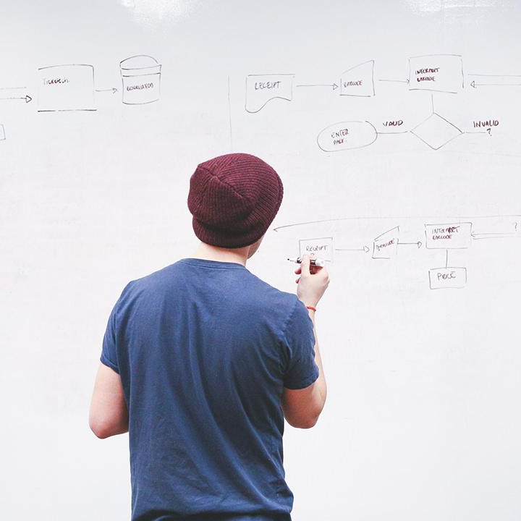
HELLO!
Here 1Crore Projects
I am here because I love to give presentations.
You can find me at @1CROREPROJECTS

Slide 2
A BLOCKCHAIN-BASED APPROACH FOR DRUG TRACEABILITY IN HEALTHCARE SUPPLY CHAIN

Slide 3

AIM OF PROJECT
The main aim of the project to improve traceability in pharmaceutical industry based on Quorum blockchain with future plans to accommodate other platforms such as Ethereum and Hyper ledger.

Slide 4
ABSTRACT
Healthcare supply chains are complex structures spanning across multiple organizational and geographical boundaries, providing critical backbone to services vital for everyday life.
The inherent complexity of such systems can introduce impurities including inaccurate information, lack of transparency and limited data provenance. Counterfeit drugs is one consequence of such limitations within existing supply chains which not only has serious adverse impact on human health but also causes severe economic loss to the healthcare industry.

Slide 5
INTRODUCTION
Healthcare supply chain is a complex network of several independent entities that include raw material suppliers, manufacturer, distributor, pharmacies, hospitals and patients. Tracking supplies through this network is non-trivial due to several factors including lack of information, centralized control and competing behaviour among stakeholders. Such complexity not only results in in-efficiencies such as those highlighted through COVID-19 pandemic but can also aggravate the challenge of mitigating against counterfeit drugs as these can easily permeate the healthcare supply chain.

Slide 6
EXISTING SYSTEM
In our existing system supply chains which not only has serious adverse impact on human health but also causes severe economic loss to the healthcare industry.
The systems are centralized leading to data privacy, transparency and authenticity issues in healthcare supply chains.

Slide 7
DISADVANTAGES
Security issues
The personal touch is very less.
Internet bandwidth

Slide 8
PROPOSED SYSTEM
In this we proposed to blockchain-based solution for the healthcare supply chain where integrity, accountability, authorization, availability, and non-repudiation are considered as key security goals.
We provide performance analysis and practical application, the results show that our system improves the query efficiency and the security of private information.

Slide 9
ADVANTAGES
High security.
Traffic and crowd can be avoided.
Time saved
Saves money

Slide 10
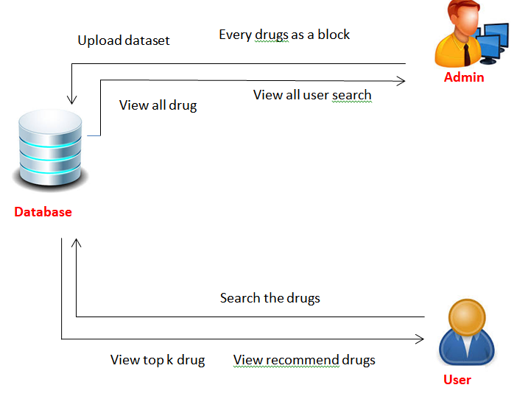
SYSTEM ARCHITECTURE

Slide 11
MODULES
In this project has three modules:
Admin
User

Slide 12
ADMIN
Login the account with correct username and Password
Admin can authorize user
Upload the dataset and every uploaded drug as a block
View all drugs
View all user search
View all purchased drugs
Graph
Logout

Slide 13
USER
Register the account with the basic information
After authorize by admin user can login the account
User can search drug based on diseases
View recommended drugs
User can purchase the drugs
View top K Drugs
Logout

Slide 14
HARDWARE REQUIREMENTS
System | Intel i3 and above
Hard Disk | 40GB
RAM | Minimum 4GB
Processor | 64-bit, four-core, 2.5 GHz minimum per core

Slide 15
SOFTWARE REQUIREMENTS
Front End Language | HTML, CSS, JAVA, JSP SERVELTS
Backend | My SQL
Operating System | Windows 10 or 11
IDE | JAVADEVELIPEMENKIT

Slide 16
FUTURE WORK
In our future work we focus to achieve end to end transparency and verifiability of drugs.

Slide 17
CONCLUSION
In this article, we have investigated the challenge of drug traceability within pharmaceutical supply chains highlighting its significance especially to protect against counterfeit drugs. We have developed and evaluated a blockchain-based solution for the pharmaceutical supply chain to track and trace drugs in a decentralized manner. We have demonstrated that our proposed solution is cost efficient in terms of the amount of gas spent in executing the different functions that are triggered within the smart contract

Slide 18
REFERENCE
[1] Shortage of Personal Protective Equipment Endangering Health Workers Worldwide. Accessed: Jun. 3, 2020. [Online]. Available: https://tinyurl. com/v5qauvp
[2] W. G. Chambliss, W. A. Carroll, D. Kennedy, D. Levine, M. A. Moné, L. D. Ried, M. Shepherd, and M. Yelvigi, ‘‘Role of the pharmacist in preventing distribution of counterfeit medications,’’ J. Amer. Pharmacists Assoc., vol. 52, no. 2, pp. 195–199, Mar. 2012.
[3] Z. RJ, ‘‘Roles for pharmacy in combating counterfeit drugs,’’ J. Amer. Pharmacists Assoc., vol. 48, pp. e71–e88, Jul. 2008.

Slide 19
THANKS!
Any questions?
You can find me at
Reach us – 1croreprojects@gmail.com
Contact / Whatsapp: 7708 150 152 / 9751 800 789 / 790 432 0834

